Slide 1
Jmeter Report
Quoc Tran - 9/2018

Slide 2
Agenda
Report Types
Report Metrics & Glossary
HTML Report
Merge Results
Q&A

Slide 3
Report Types
GUI
Listerners
Non-GUI
HTML report

Slide 4
Popular Listeners
TABLE/TREE
Summary Report
View Results in Table
View Results Tree
GRAPH
Graph Results
Aggregate Graph
Response Time Graph

Slide 5
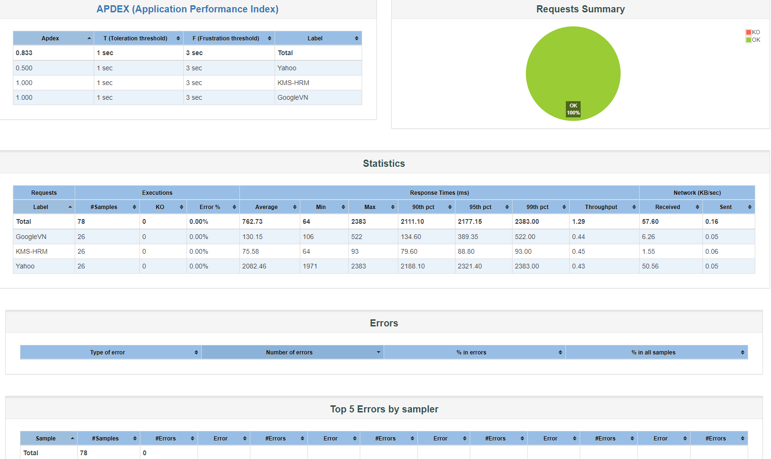
HTML Report

Slide 6
2. Glossary
Elapsed time (=Response time = Sample time = Load time): From just before sending the request to just after the last response has been received. It does not include the time needed to render the response, nor does JMeter process any client code.
Latency time: From just before sending the request to just after the first response has been received. It includes all the processing needed to assemble the request as well as assembling the first part of the response, which in general will be longer than one byte
=> Elapsed Time = Latency + Processing Time
Connect Time: JMeter measures the time it took to establish the connection (between client and server), including SSL handshake. It is not automatically subtracted from latency

Slide 7
2. Glossary
Standard Deviation is a measure of the variability of a data set. This is a standard statistical measure.
Throughput is calculated as requests/unit of time. The time is calculated from the start of the first sample to the end of the last sample. This includes any intervals between samples, as it is supposed to represent the load on the server.
The formula is: Throughput = (number of requests) / (total time).

Slide 8

2. Report Metrics
Aggregate Report
Graph Results

Slide 9
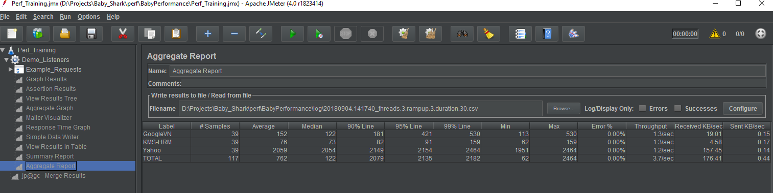
Label - The label of the sample.
# Samples - The number of samples with the same label
Average - The average time of a set of results
% Error - Percent of requests with errors
Throughput - Requests per second
Received KB/sec - Received Kilobytes per second
Sent KB/sec - Sent Kilobytes per second
Median - The time in the middle of a set of results. 50% of the samples took no more than this time; the remainder took at least as long this
90% Line - 90% of the samples took no more than this time. The remaining samples took at least as long as this
95% Line - 95% of the samples took no more than this time. The remaining samples took at least as long as this
99% Line - 99% of the samples took no more than this time. The remaining samples took at least as long as this
Min/Max - The shortest/longest time for the samples with the same label

Slide 10
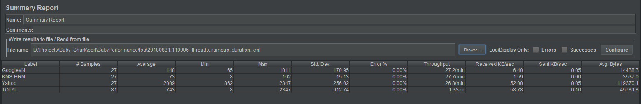
Std. Dev. - the Standard Deviation of the sample elapsed time
Avg. Bytes - average size of the sample response in bytes

Slide 11
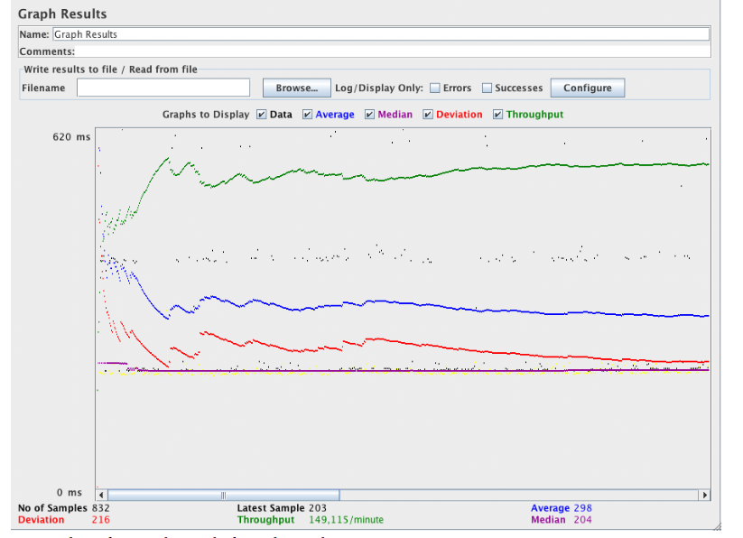
Data - plot the actual data values
Average - plot the Average
Median - plot the Median (midway value)
Deviation - plot the Standard Deviation
Throughput - plot the number of samples per unit of time
Latest Sample is the current elapsed sample time

Slide 12
Interpreting Jmeter Metrics
Elapsed Time / Connect Time / Latency: should be as low as possible, ideally less than 1 second. Amazon found every 100ms costs them 1% in sales, which translates to several millions of dollars lost,
Median: should be close to average elapsed response time,
XX% line: should be as low as possible too. When it’s way lower than average elapsed time, it indicates that the last XX% requests have dramatically higher response times than lower ones,
Standard Deviation: should be low. A high deviation indicates discrepancies in responses times, which translates to response time spikes.

Slide 13
3. HTML Report
Non-GUI Mode
Example:
jmeter -n -t C:\jmeter\my-test-plan.jmx -l C:\jmeter\my-test-plan-result.jtl -e -o C:\jmeter\html-report
Note:
-n: This specifies JMeter is to run in non-gui mode
-t: [name of JMX file that contains the Test Plan].
-l: [name of JTL file to log sample results to]
-g: [path to CSV file] generate report dashboard only
-e: generate report dashboard after load test
-o: output folder where to generate the report dashboard after load test. Folder must not exist or be empty
Referrence: https://jmetervn.com/2017/01/09/running-jmeter-in-non-gui-mode/

Slide 14
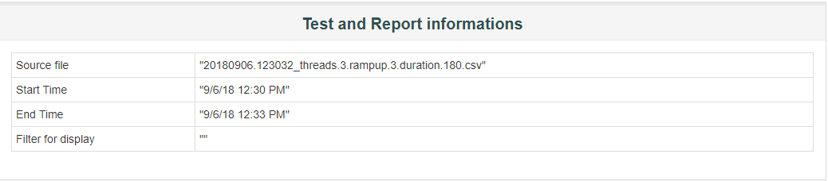
Dashboard

Slide 15
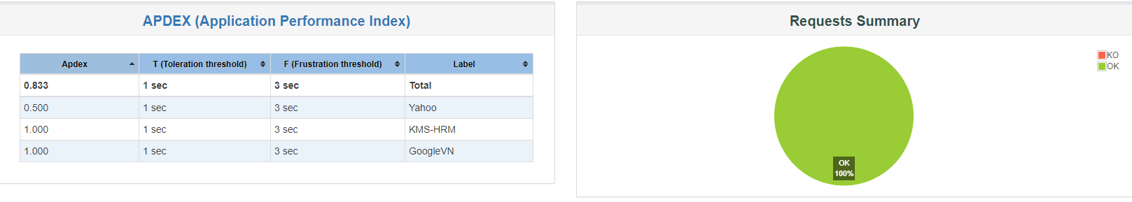
APDEX: The table that computes for every transaction the APDEX based on configurable values for tolerated and satisfied thresholds

Slide 16
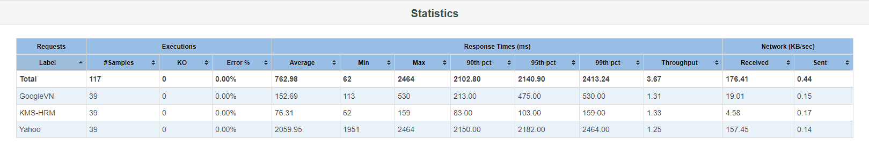
A Statistics table providing in one table a summary of all metrics per transaction including 3 configurable percentiles: Executions, Response Times, Network

Slide 17
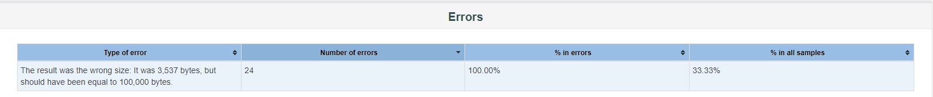
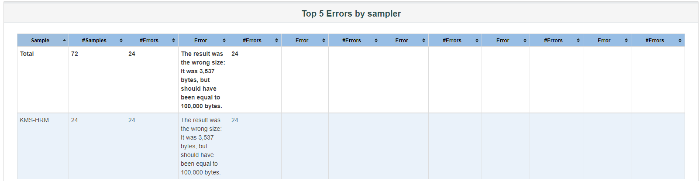
An Errors table providing a summary of all errors and their proportion in the total requests
A Top 5 Errors by Sampler table providing for every Sampler (excluding Transaction Controller by default) the top 5 Errors

Slide 18
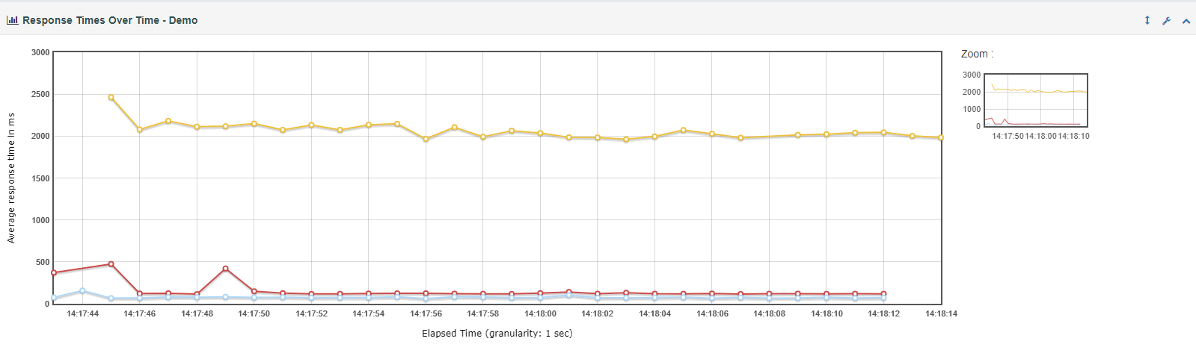
Charts
The response time variation for each sample over the period of the test

Slide 19
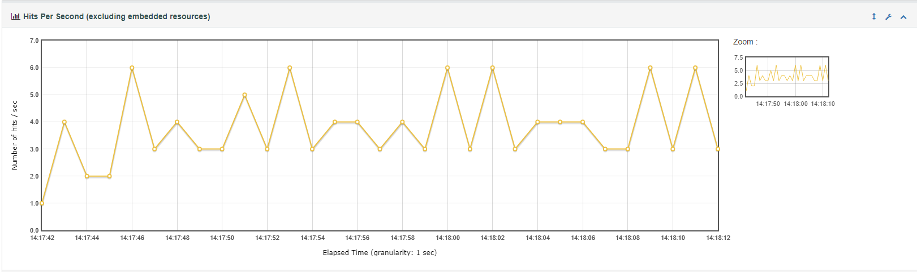
Hits per Second listener provides data about the number of samples executed over the period of time
Referrence: https://www.blazemeter.com/blog/jmeter-listeners-part-3-listeners-calculate-distribution-metrics

Slide 20
4. Merge Results
Merge Results is a tool to merge files of results (to simplify the comparison of two or more load tests)
Installation:
Download plugins-manager.jar, Standard Set, Extras Set and then put them into lib/ext directory, then restart JMeter.
In Jmeter > Options > Plugins Manager > Available Plugins
Select “Merge Results” and click “Apply Changes and Restart Jmeter”
Select “Test Plan” and add “jp@gc - Merge Results”

Slide 21
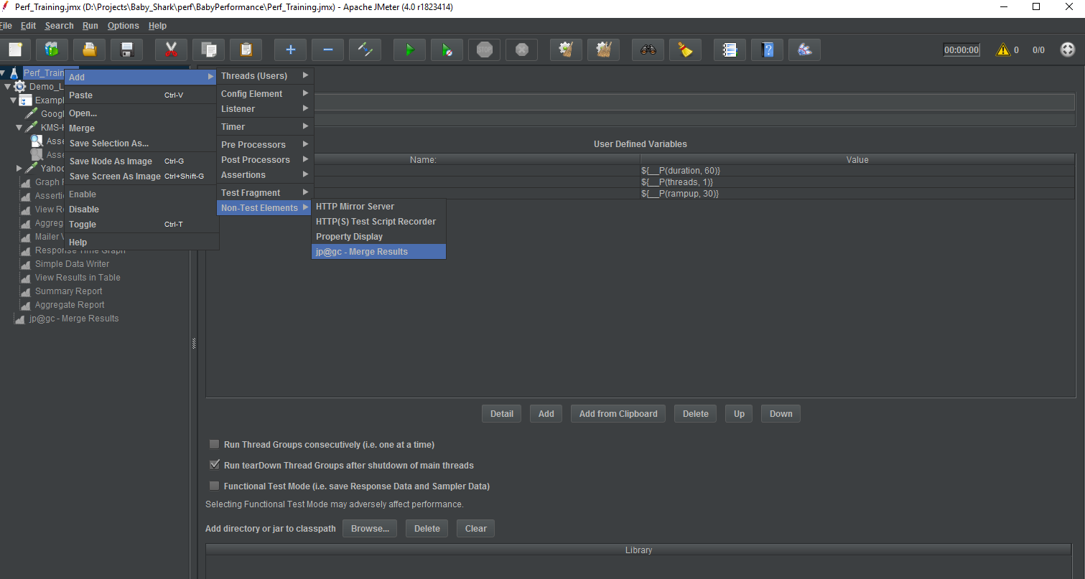

Slide 22
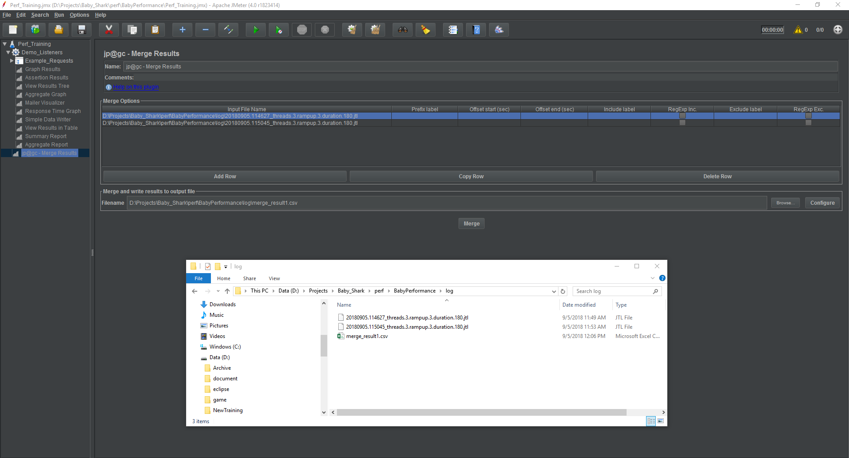

Slide 23


Slide 24


